Slide 1
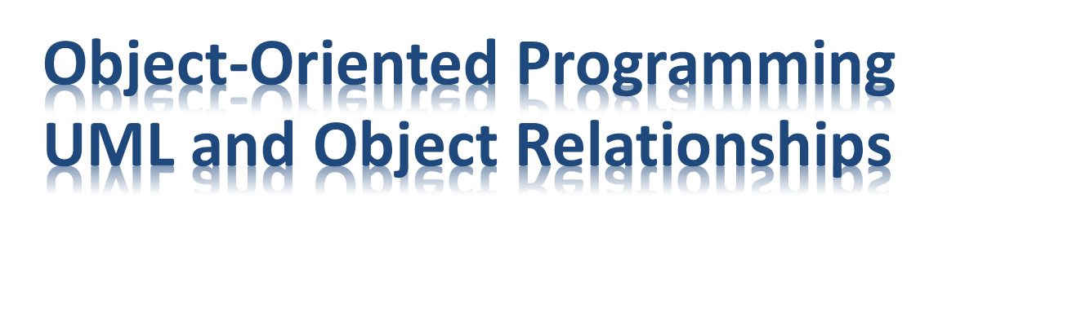
100年度教育部資訊軟體人才培育推動中心
軟體工程推廣分項計畫
編輯委員 國立台北科技大學 陳偉凱教授

Slide 2


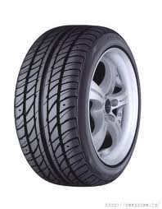
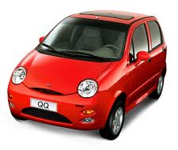

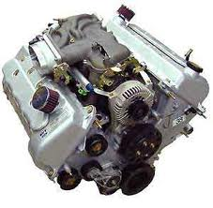
An object-oriented program may be viewed as a collection of interacting objects
UML can be used to express object relationships
Object-OrientedProgramming UML and Object Relationships

Slide 3

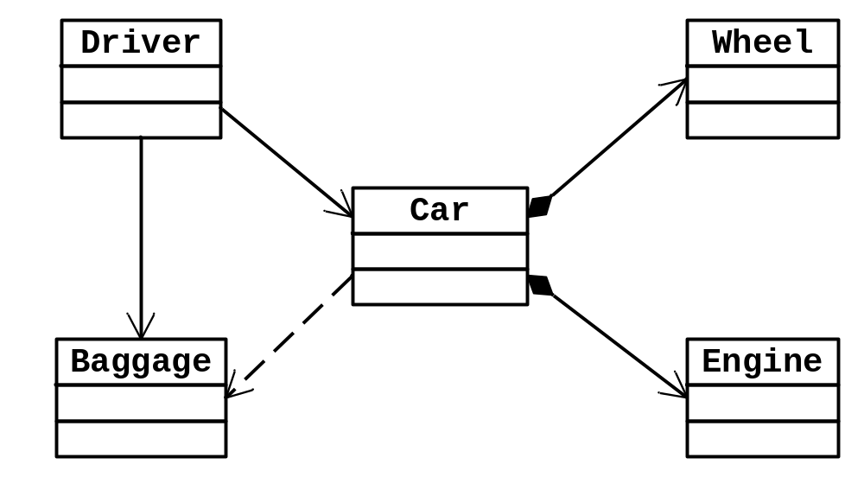
Relationship
Object-OrientedProgramming UML and Object Relationships

Slide 4

Successor to OOAD methods
  late 1980s and early 1990s
Unifies
  Jacobson & OMT (Booch & Rumbaugh)
Graphical notation used to express designs
  Use cases
  Class diagrams
  Interaction diagrams (Sequence & communication diagrams)
  Package diagrams
  State diagrams
  Activity diagrams
  Deployment diagrams
GoF Book
Object-OrientedProgramming UML and Object Relationships

Slide 5

Can be used for different perspectives
  Conceptual
    Describe things in a situation of the real world or domain of interest
    E.g., domain model
  Implementation
    Describe software implementations in a particular technology (e.g., Java)
    E.g. design class diagram
Covered in this lecture
Object-OrientedProgramming UML and Object Relationships

Slide 6

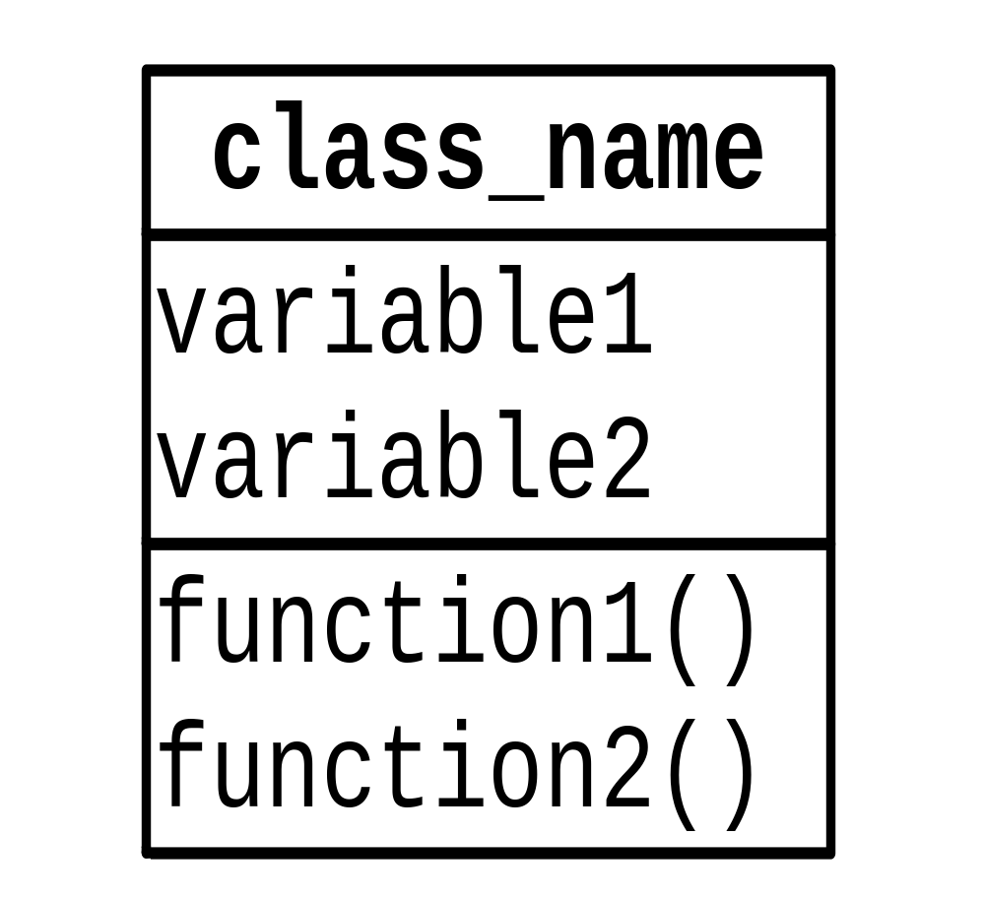
+ public
# protected
- private
Abstract
Concrete
data type
parameter
Object-OrientedProgramming UML and Object Relationships

Slide 7

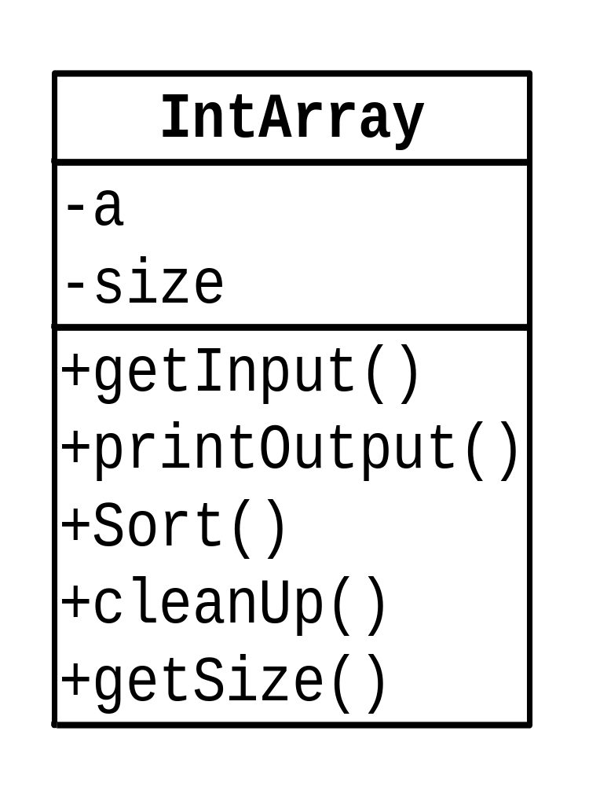
Object-OrientedProgramming UML and Object Relationships

Slide 8

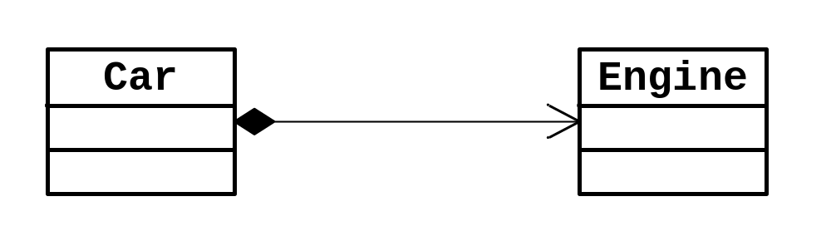
An object is related to some other objects
relationship
Object-OrientedProgramming UML and Object Relationships

Slide 9

Dependency (uses a)
Association (knows a)
Composition (has a)
Aggregation (has a)
Inheritance (is a)
Implementation (can do)
X
Y
X
Y
X
Y
X
Y
Y
X
Y
X
Object-OrientedProgramming UML and Object Relationships

Slide 10

“Uses a”
  Dependency
  X issues a function call to a member function of Y
  Short term relationship
“Knows a”
  Association
  X is aware of Y; X contains a pointer or reference to Y
  X can issue a function call to a member function of Y
  Long term relationship
X
Y
X
Y
Object-OrientedProgramming UML and Object Relationships

Slide 11

“Is a” relationships
  Inheritance
  X class is derived from Y
“Has a” relationships
  Composition
  X contains Y as members
Y
X
X
Y
Object-OrientedProgramming UML and Object Relationships

Slide 12

“Is a” relationships
  Inheritance
  X is derived from Y
“Can do” relationships
  Implementation
  X can do (replace) the jobs of Y;
  but X is not Y
  Many OO languages allows only
  single inheritance
Y
X
Y
X
Object-OrientedProgramming UML and Object Relationships

Slide 13

Both are “Has a” or “part-of” relationship
Composition
  A stronger variety of aggregation
  A Y object may belong to only one X object
  A Y object is expected to live and die with the X object
    delete X → delete Y
Aggregation
  A Y object can be shared, i.e., a Y object may belong to several different objects
X
Y
X
Y
Following Larman OOAD: use of aggregation is NOT recommended
Object-OrientedProgramming UML and Object Relationships

Slide 14

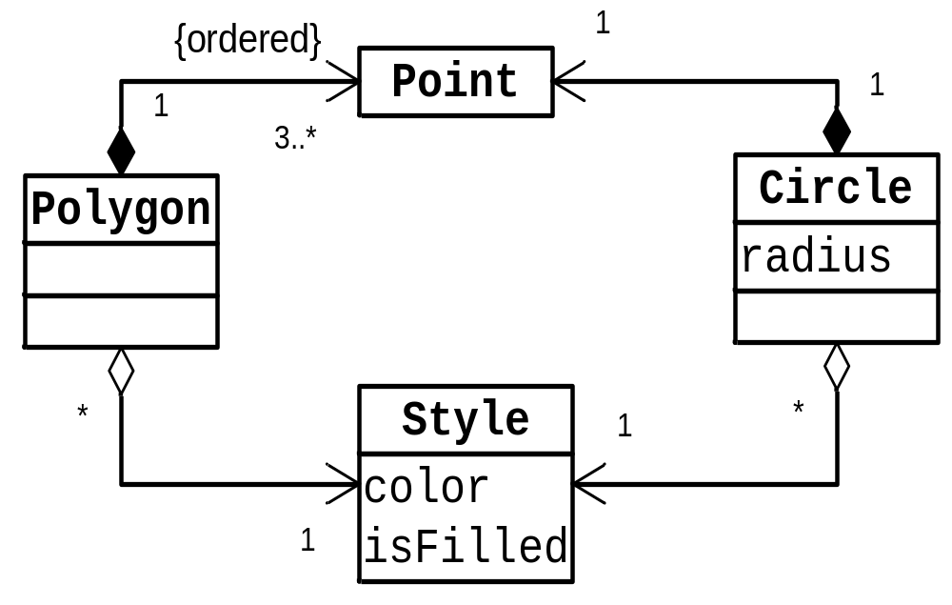
Delete Polygon → delete Point
Delete Polygon → delete Style
a Point may appear in only one Polygon or Circle
X
Larman: use association instead of aggregation
Multiplicity
a Style may be shared by many Polygons and Circles
Object-OrientedProgramming UML and Object Relationships

Slide 15

Car ⬄ Engine ?
Car ⬄ Baggage ?
Driver ⬄ Car ?
Driver ⬄ Baggage ?
Person ⬄ Cell Phone ?
Human ⬄ Brain ?
Fighter ⬄ Bomb ?
Fighter ⬄ F16
Bomb ⬄ Explosive
Bomb ⬄ Nuclear Bomb
Tree Node ⬄ Child of Tree Node ?
Tree Node ⬄ Parent of Tree Node ?
Hero ⬄ Life ? (Game)
Hero ⬄ Score ? (Game)
Hero ⬄ Map ? (Game)
→ Composition
→ Association/Composition/Dependency
→ Association/Dependency
→ Association/Composition/Dependency
→ Association/Composition/Dependency
→ Composition
→ Association
→ Inheritance
→ Composition/Association/Inheritance
→ Inheritance
→ Composition
→ Association (if needed)
→ Composition/Attribute
→ Association/Dependency
→ Association/Dependency
註：僅供參考，沒有一定的答案
Object-OrientedProgramming UML and Object Relationships

Slide 16
Flight 123 ⬄ Airplane ?
Flight 123 ⬄ Airport ?
Flight 123 ⬄ Passenger ?
Flight 123 ⬄ Flight Captain ?
Flight 123 ⬄ Flight Attendant ?
Airplane ⬄ Boeing 747 ?
Airplane ⬄ Seat ?
Airplane ⬄ Fuel ?
Passenger ⬄ Flight ?
Passenger ⬄ Ticket ?
Passenger ⬄ Travel Agent ?
Ticket ⬄ Price ?
→ Association/Dependency
→ Association
→ Association/Dependency
→ Association/Dependency
→ Association/Dependency
→ Inheritance
→ Composition
→ Composition/Attribute
→ Association/Dependency
→ Association/Dependency
→ Association/Dependency
→ Composition/Attribute
註：僅供參考，沒有一定的答案
Object-OrientedProgramming UML and Object Relationships

Slide 17

X
Y
“Uses a” relationship
class X {
…
void f1(Y y) {…; y.Foo(); }
void f2(Y *y) {…; y->Foo(); }
void f3(Y &y) {…; y.Foo(); }
void f4() {Y y; y.Foo();… }
void f5() { …; Y::StaticFoo(); }
};
Object-OrientedProgramming UML and Object Relationships

Slide 18

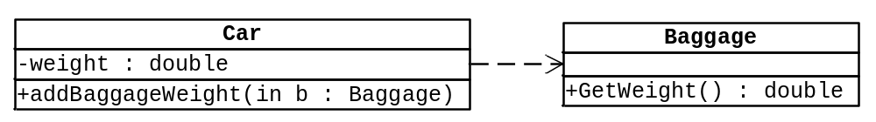
Parameters: in, out
class Car {
public:
…
void addBaggageWeight(Baggage *baggage);
…
private:
double weight;
};
void Car::addBaggage(Baggage *baggage) {
weight += baggage.GetWeight();
}
Car uses Baggage
Object-OrientedProgramming UML and Object Relationships

Slide 19

X
Y
“Knows a” relationship
class X {
X(Y *y) : y_ptr(y) {}
void SetY(Y *y) { y_ptr = y; }
…
void f() {y_ptr->Foo();}
Y *y_ptr; // X keeps a pointer (reference) to Y
};
Two choices
Object-OrientedProgramming UML and Object Relationships

Slide 20

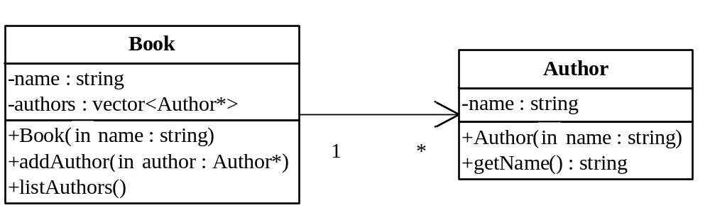
class Book {
public:
Book(string name);
void addAuthor(Author *author);
void listAuthors();
private:
string name;
vector<Author*> authors;
};
void Book::listAuthors() {
cout << "Authors of " << name
<< " are:\n";
for(size_t i = 0; i < authors.size(); i++)
cout << " "
<< authors[i]->getName()
<< endl;
}
Book knows Author
Object-OrientedProgramming UML and Object Relationships

Slide 21

Book
Author
How is an association created?
Example #1 Example #2
… …
Author a(); Author a();
Book b(&a); Book b();
… …
b.ListAuthor(); b.addAuthor(&a);
… …
b.ListAuthor();
Object-OrientedProgramming UML and Object Relationships

Slide 22

X
Y
“Has a” relationship
class X {
…
Y a; // 1; Composition
Y b[10]; // 0..10; Composition
};
Java?
Life cycle of a and b are controlled by X
Object-OrientedProgramming UML and Object Relationships

Slide 23

X
Y
class X {
X() { y_ptr = new Y[10]; }
~X(){ delete [] y_ptr; }
…
Y *y_ptr; // 0..10; Composition
};
NOT an Association
Object-OrientedProgramming UML and Object Relationships

Slide 24

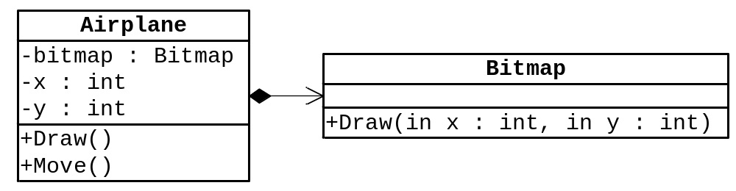

class Airplane {
public:
…
void Move();
void Draw();
private:
Bitmap bitmap;
int x, y;
};
void Airplane::Move() {
x += …;
y += …;
}
void Airplane::Draw() {
bitmap.Draw(x, y);
}
Airplane has Bitmap
Object-OrientedProgramming UML and Object Relationships

Slide 25

X
vector<Y>
Y
Implementation detail
X
Y
class X {
…
vector<Y> a;
};
Hiding implementation detail
Composition of vector<Y>
NOT Composition of Y
Object-OrientedProgramming UML and Object Relationships

Slide 26

No example here
  Never use aggregation (Larman)
  Use Association instead of Aggregation
X
Y
X
Y
Object-OrientedProgramming UML and Object Relationships

Slide 27

class Y {
...
};
class X : public Y {
...
};
Y
X
“is a” relationship
Object-OrientedProgramming UML and Object Relationships

Slide 28

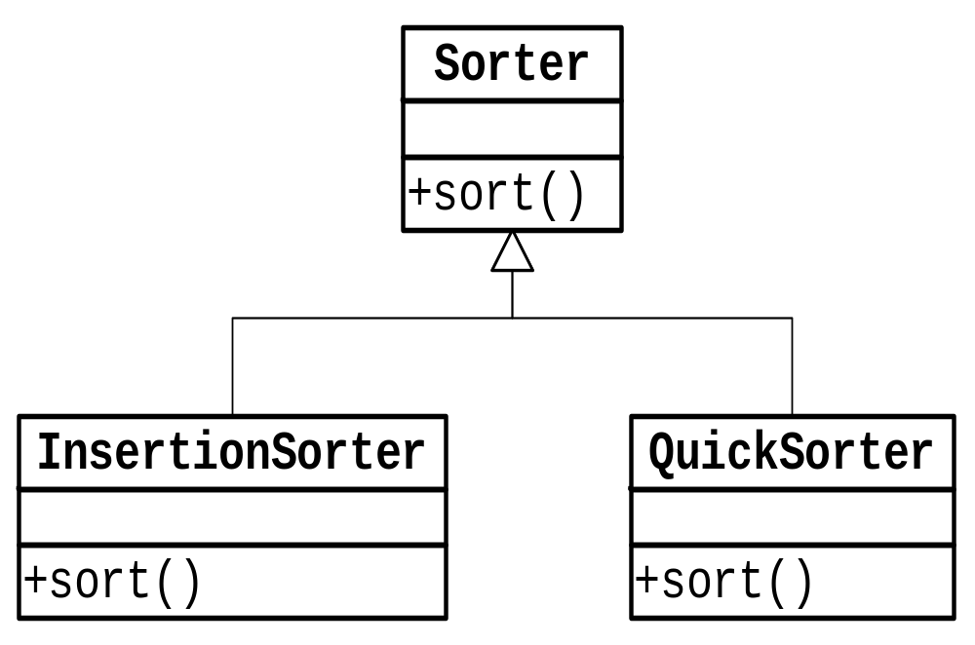
Object-OrientedProgramming UML and Object Relationships

Slide 29

public interface Y {
int Foo();
}
class X : Y
{
public int Foo()
{
…
}
}
No fields; no method body
Y
X implements Y
X
“Can do” relationship
Object-OrientedProgramming UML and Object Relationships

Slide 30

class Y {
...
};
class X : public Y {
...
};
Y
No variables
Only pure virtual functions
X
C++ allows multiple inheritance
Object-OrientedProgramming UML and Object Relationships

Slide 31

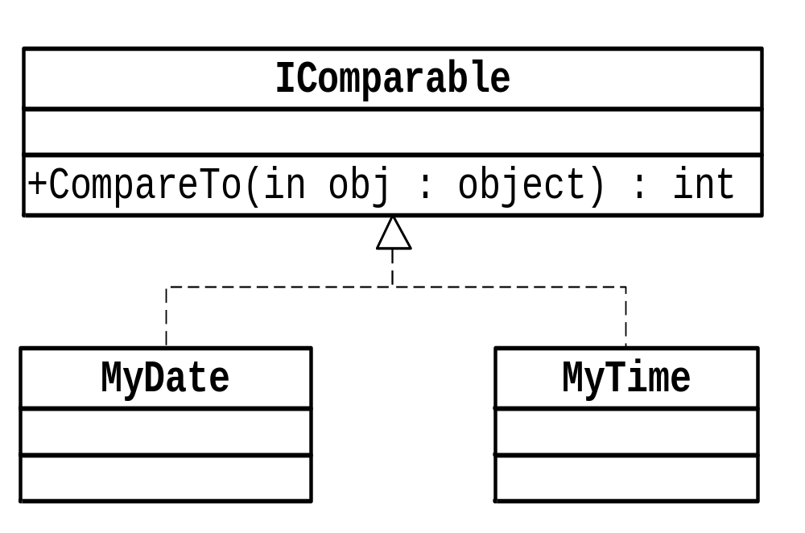
Object-OrientedProgramming UML and Object Relationships

Slide 32

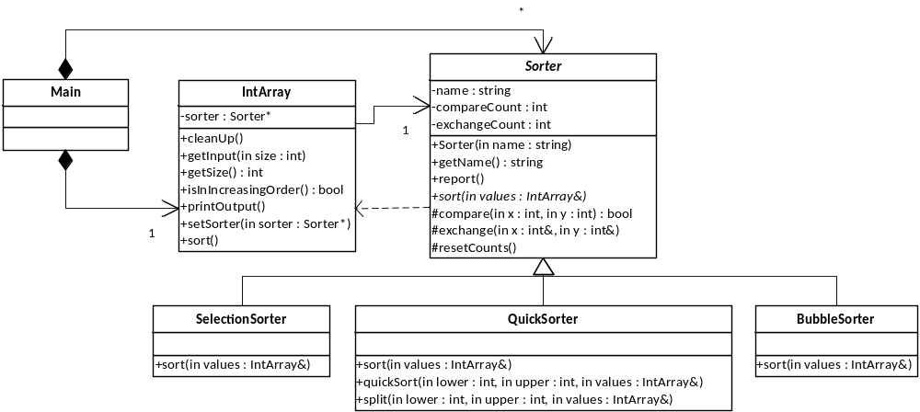
Object-OrientedProgramming UML and Object Relationships

Slide 33

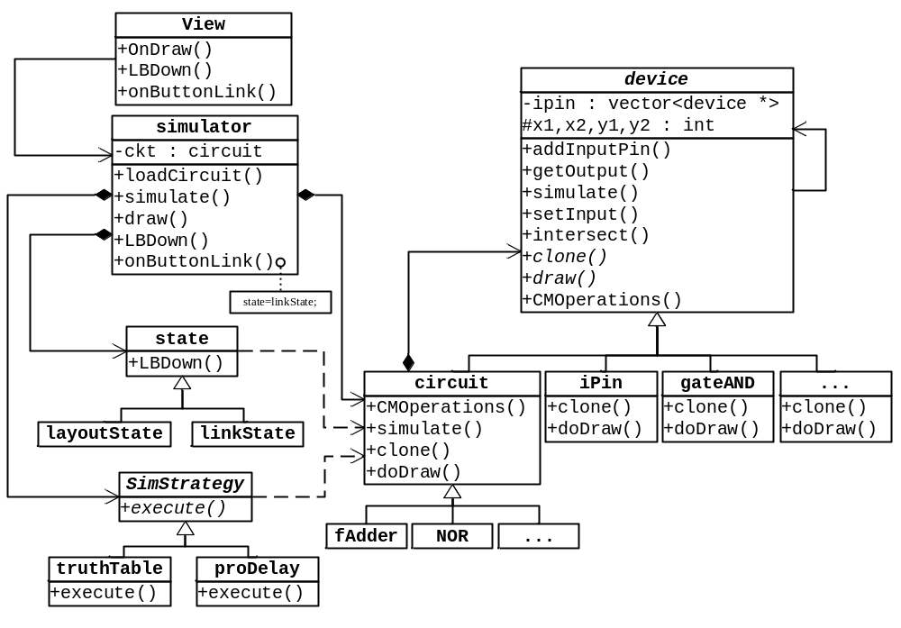
Logic circuit simulator
Object-OrientedProgramming UML and Object Relationships

Slide 34

練習使用UML繪圖工具繪製Class diagram
  請參考Lab 1
Object-OrientedProgramming UML and Object Relationships

Slide 35

依據原始程式繪製對應的Class Diagram
  請參考Lab 2
Object-OrientedProgramming UML and Object Relationships

Slide 36

依據需求設計Class Diagram
  請參考Lab 3
Object-OrientedProgramming UML and Object Relationships

